Slide 1

Sales Techniques
Presented by
Adam Garman

Slide 2
Mastering the 7-Day Post-Closing Call
Turning Customers into Loyal, Referring Clients

Slide 3
Agenda
Amir Syed’s Core Sales Philosophy
The 5 Major Points of Sale
Why Post-Closing Matters Most
The 7-Day Post-Closing Call: Framework & Script
The Real Benefits (Why This Call Changes Your Business)
Commitment and Q & A

Slide 4
Amir’s Core Sales Philosophy
“PROFESSIONAL SALES IS STRUCTURED SEQUENCING. There is POWER in PROCESS. PROCESS > Personality”
“Each stage in the journey demands a unique approach and carefully crafted language. With intentional practice and persistence, you can master every phase and transform it into a seamless, well-orchestrated process.”
– Amir Syed

Slide 5
The 5 Major Points of Sale
1. Lead-to-Appointment (LTA)
2. Initial Loan Consultation (ILC)
3. Rate Lock Consultation (RLC)
4. Post Closing Consultation (PCC) ← TODAY’S FOCUS
5. Annual Mortgage Consultation (AMC)
Notes:
Every borrower journey has exactly 5 sales opportunities. Each of these points present an opportunity for you to build rapport and position yourself as their trusted advisor. Miss #4 and you leave massive money and referrals on the table.”

Slide 6
Why Post-Closing Matters Most
Nothing in customer service is worse than not following up with recent clients
Customers feel abandoned
No education → confusion → bad reviews
No sales anchors → refinance elsewhere
Lifetime Value ≈ 5 transactions ($20k+ income)

Slide 7
The 7-Day Post-Closing Call
The 777 Jackpot Strategy
Thursday “Power Hour: Closed Database”
In this order:
7-day Post-Closing calls (today’s focus)
7-day upcoming Loan Anniversary calls
7-day upcoming Birthday calls
Notes:
Block 1 hour every Thursday morning in green. NEVER move it.”

Slide 8
The 7-Day Post-Closing Call
Why to call at this day and time specifically?
Closing fresh → high emotional connection
Borrowers excited but nervous → teaching moment
Thursday morning = higher pickup
“Spontaneous” → personal & caring
Notes:
This call is the difference between transactional LO and trusted advisor.

Slide 9
The 7-Day Post-Closing Call
What should I cover?
1st Payment
Servicing Transfers
Escrows
Future recast
Tax Exemptions
Junk Mail & Refinance Solicitation
Refinancing in the Future
Percy/HomeBot
Financial Advisor
Feedback
Online Testimonial
Referral
AMC Sales Anchor
Notes:
This call is the difference between transactional LO and trusted advisor.

Slide 10
The 7-Day Post-Closing Call
Framework and Scripts
Initial Starter Pleasantries and Questions:
Start every call enthusiastically.
Remember, most people are excited and still nervous about their new loan.
"Hi [name]! It's [your name]! Am I catching you at the right time? Do you have just 2-3
minutes tops, please?
[pause, listen]
'Thank you [name], well, I'm calling to first off congratulate you on the [new home/
new home loan] and secondly to thank you, sincerely, for trusting us with your
mortgage; it means the world to us.
[pause, listen]
Notes:
This call is the difference between transactional LO and trusted advisor.

Slide 11
The 7-Day Post-Closing Call
Framework and Scripts
Permission Based Educating:
"Well, now that you've officially closed on your home [property], I want to educated
you on a few more important things. Would you mind if I shared a few of them with
you?“
[pause, listen]
"Excellent! Thank you!"
Notes:
This call is the difference between transactional LO and trusted advisor.

Slide 12
The 7-Day Post-Closing Call
Framework and Scripts
Educating:
1st Payment & Escrows:
"Do you have any questions at all regarding your first payment and how taxes and
home insurance are escrowed? [if the latter is applicable]
Well, remember, since your property taxes and home insurance are included in your
monthly mortgage payment, you will still receive a bill potentially from your respective
county and home insurance agent, so do NOT double pay, and when in doubt, please
feel free to call us."
Notes:
This call is the difference between transactional LO and trusted advisor.

Slide 13
The 7-Day Post-Closing Call
Framework and Scripts
Property Tax Exemptions:
''Additionally, almost every major County provides some sort of homeowner's tax
exemptions, especially for owner-occupied homeowners, so please search your County's
Property Tax Exemption options online when you have a chance; it can help you save
some money every year on your property taxes.“
Notes:
This call is the difference between transactional LO and trusted advisor.

Slide 14
The 7-Day Post-Closing Call
Framework and Scripts
Junk Mail & Refinance Solicitations:
"Next up, now that you are a homeowner, prepare yourself because you will, unfortunately,
start to receive a lot of junk mail, especially from other lenders trying to convince you to
refinance. Make sure to shred that type of mail, and when in doubt, just contact us and
we can help determine what is legit or not.“
"So far, so good?“
[Pause, listen]
Notes:
This call is the difference between transactional LO and trusted advisor.

Slide 15
The 7-Day Post-Closing Call
Framework and Scripts
Refinancing:
"Speaking of refinancing, my team and I constantly monitor interest rates, so if the right
opportunity presents itself, I will call you to discuss it. However, please call me proactively
if you are offered any refinancing options. I always have your best interest first and want
to make sure you never get into the wrong loan. Sounds good?“
Notes:
This call is the difference between transactional LO and trusted advisor.

Slide 16
The 7-Day Post-Closing Call
Framework and Scripts
MyHomelQ or HomeBot:
" ... thank you [name]. Also, I invested in an awesome tool that's complimentary to you
called myHome IQ. It's a monthly email report that is fully customized to your home and
mortgage.
You'll have a bunch of features on there with one giving you insight into your home value.
My other clients absolutely love it, and you should see your first report in 30 days or so!"
Notes:
This call is the difference between transactional LO and trusted advisor.

Slide 17
The 7-Day Post-Closing Call
Framework and Scripts
Feedback
." .. Well, as we wrap up, thank you again [name], for picking me as your Loan Officer; I
never take it for granted ... “
". ..thinking back, how do you feel we did for you overall?“
". .. I know there's no such thing as perfection, but we're always pursuing it. What was one
thing that we could have done better? Please be honest.“
[pause, listen, dig deeper if need be]
Notes:
This call is the difference between transactional LO and trusted advisor.

Slide 18
The 7-Day Post-Closing Call
Framework and Scripts
Close
"Thank you for all that [name]; before we wrap, can I please ask you for two favors?
[pause, gain commitment]?“
Online Testimonial Request
If I send you a link to my Google reviews, would you be open to writing a quick on line
testimonial for us? It would mean the world to us.
(b) Referral
"Thank you, [name]! Secondly, when the topic of mortgages comes up with your coworkers
or friends, would you be open to saying you have a great mortgage guy [gal]?
[pause, listen]
Notes:
This call is the difference between transactional LO and trusted advisor.

Slide 19
The 7-Day Post-Closing Call
Framework and Scripts
AMC Sales Anchor
"Thank you for taking the time [name], I hope all the quick education today was helpful
and this won't be the last time we connect.
I'd like to reach back out at least once a year around your home anniversary so we can
schedule a quick 15-30 30-minute Annual Mortgage Review call. Everyone loves those,
as they're basically like a mortgage efficiency check-up call where I help you ensure you
are maximizing your home loan.
Thank you again, [name]. Please do not hesitate to contact me if you need anything."
Notes:
This call is the difference between transactional LO and trusted advisor.

Slide 20
The 7-Day Post-Closing Call
Recap
Start every call enthusiastically.
Ask questions and then pause, LISTEN!
Use a checklist to make sure you touch on everything.
Drop that Sales Anchor!
Notes:
This call is the difference between transactional LO and trusted advisor.

Slide 21
7-Day Birthdays & Anniversaries
Once you have completed your 7-Day Post Closing calls, pivot into calling every client that has an upcoming home loan anniversary or a birthday within the next 7 days.
Notes:
This call is the difference between transactional LO and trusted advisor.

Slide 22
The Real Benefits (Why This Call Changes Your Business)
This can seem like a lot but remember this: the Lifetime Value (LTV) of a first-time homebuyer is 5x!
1. First home
2. Refinance
3. Move up home
4. Refinance
5. Refinance
If each transaction is worth $4k to you, that’s $20k…and that’s not counting referrals.

Slide 23
Commitment From You
✓ Block first Thursday Power Hour
✓ Make first 7-day calls next Thursday
✓ Report back on how it went

Slide 24
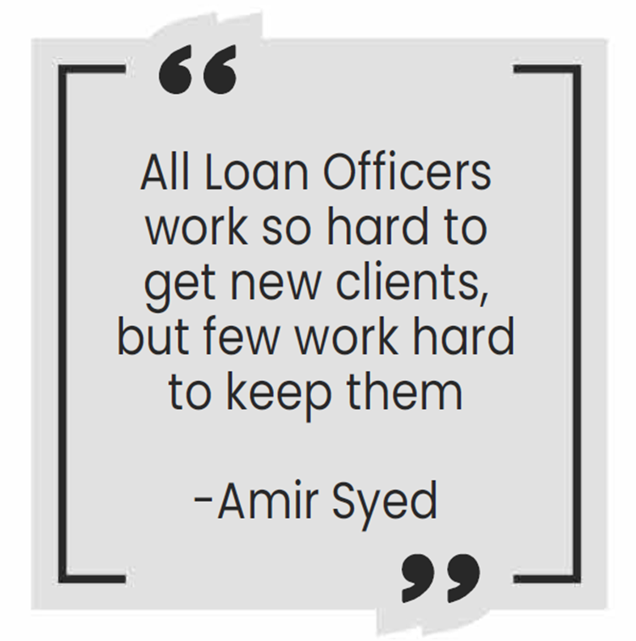
Q&A

